Slide 1
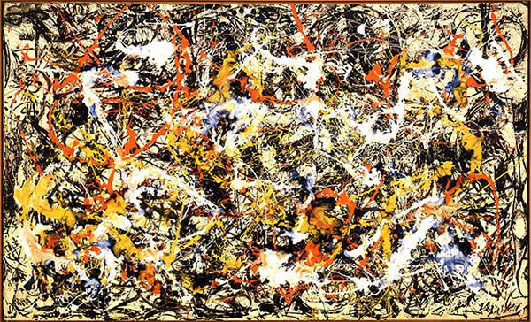
Jackson Pollock
Abstract Expressionist Painter

Slide 2
Who is Jackson Pollock?
An influential American painter.
Youngest of five boys.
Born in 1912 and died in 1956.
A major figure in the Abstract Expressionist Movement.
During the 1930s, Pollock occasionally stole food and gasoline because of his dire financial situation.
Known for his unique style of drip painting.
He painted with house paints using hardened brushes, sticks, and basting syringes as tools.
Most of his works were very large.
He used his whole body to paint and worked from every side of his artwork.

Slide 3
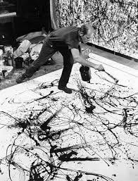
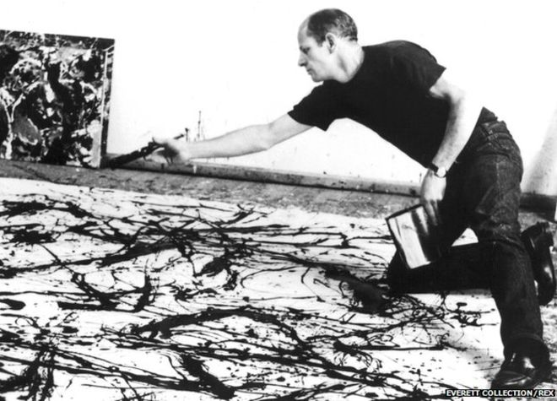
Jackson Pollock at work
“Flinging, dripping, pouring, and spattering, he would move energetically around the canvas, almost as if in a dance, and would not stop until he saw what he wanted to see.” – www.jackson-pollock.org

Slide 4
What is Abstract Expressionism?
A development of abstract art that originated in New York in the 1940s and 1950s
Art aimed at subjective emotional expression with particular emphasis on the creative spontaneous act (e.g., action painting)
Leading figures were Jackson Pollock and Willem de Kooning
Artists borrowed and melded different art styles, and enjoyed creating their own individual styles
A lot of artists used huge canvases, and used their imagination to create what they were making.
Abstract art- a style of art that is not realistic. Unusual lines, colors, and shapes make the subject look unrealistic. It is often characterized by the use of geometric lines and shapes and bold, bright colors.
Expressionism – a style of art that is about expressing the artist’s emotions rather than impressions of the external world

Slide 5
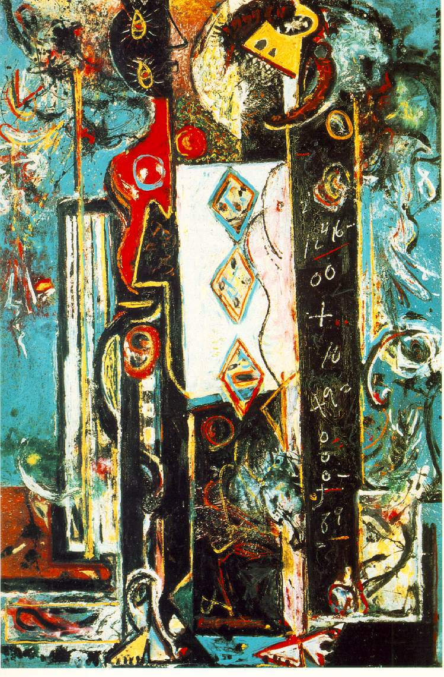
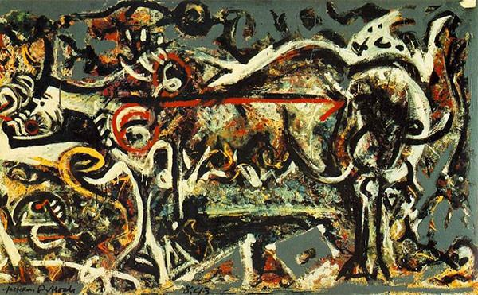
Male and Female
First major work
The She Wolf
The first painting to be put into a museum collection

Slide 6
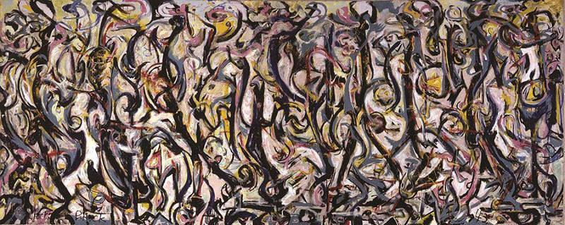
Mural, 1943
First really big piece of art, one of his largest (8’X20’). It also marked a turning point in his art. It’s size, abstraction and style set the stage for his later work.

Slide 7
This is one of Jackson Pollock’s most ambitious works. Known for it’s visual brilliance and for evoking deep emotions to those that view it. (93.5 x 155 inches)
Convergence, 1952

Slide 8
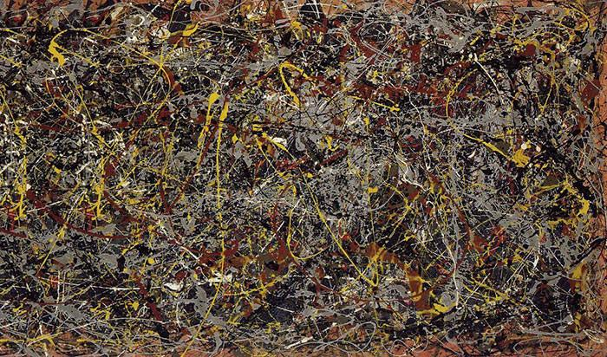
Pollock stopped naming his pictures (giving them numbers instead) because he didn't want people to look for a subject matter or a meaning in his art. Instead he wanted the appreciate the painting for what it was.
No. 5 is one of the most expensive pieces of artwork ever sold. In 2006, this piece of art sold for $140 million. (8 feet x 4 feet )
No. 5, 1948

